Slide 1
ASL Overview
Jan-2017

Slide 2
Contents
ASL Purpose
ASL Inputs / Outputs
ASL Process Overview
Review Time / Lead Time Slotting
Demand Profiling
Seasonal Factors
Assumptions and Caveats
Questions
Appendix

Slide 3
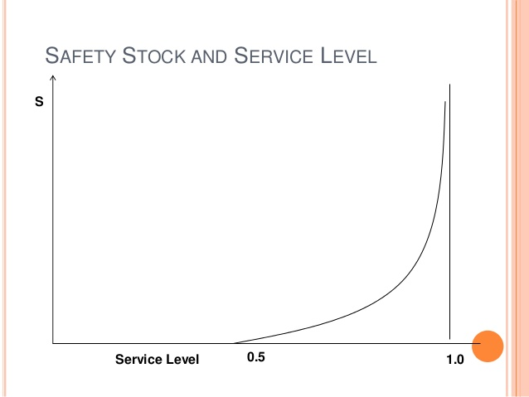
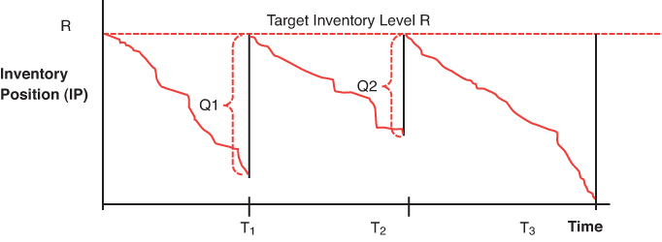
ASL Purpose – Calculate Safety Stock
ASL Purpose
ASL Inputs / Outputs
ASL Process Overview
Review Time / Lead Time Slotting
Determine Seasonality
Demand Profiling
Case Pack Adjustment
Assumptions and Caveats
Questions
Appendix
Calculate, for each str-sku, the safety stock necessary to achieve a given Service Level (Inventory Depth)
Safety Stock
Service Level
50%
75%
100%
OUTL
O2
O1
Safety Stock
RTLT
RTLT

Slide 4
ASL Purpose – Part of Inventory Strategy
ASL Purpose
ASL Inputs / Outputs
ASL Process Overview
Review Time / Lead Time Slotting
Determine Seasonality
Demand Profiling
Case Pack Adjustment
Assumptions and Caveats
Questions
Appendix
ASL helps simplify Service Level setting
Set a Service Level, obtain a corresponding “Depth”
ASL should take care of all background math so we can set SL’s as part of a company or class strategy (e.g., ASL compensates for seasonality, job lot, pack size, etc.)
Currently captures RTLT variability, pack sizes, and job lots well
WIP: Seasonality, new SKUs
Depth
Simulates last 365 days of transactions / sales
Walks through each day’s transaction as if you had current OH level
Calculates “captured” sales and “lost” sales
Better measure of having the right level of inventory vs OOS %

Slide 5
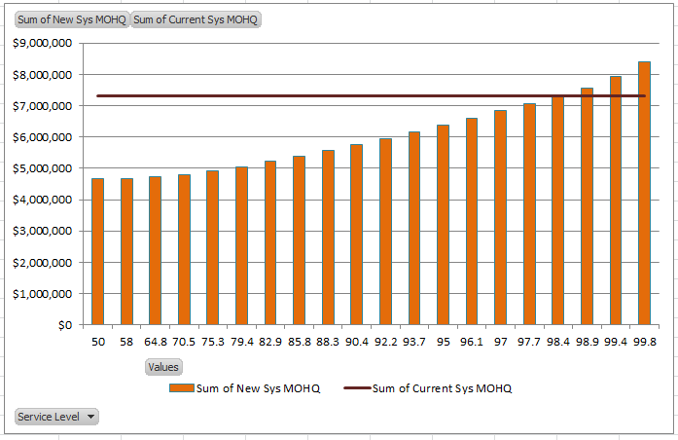
ASL Inputs and Outputs
ASL Purpose
ASL Inputs / Outputs
ASL Process Overview
Review Time / Lead Time Slotting
Determine Seasonality
Demand Profiling
Case Pack Adjustment
Assumptions and Caveats
Questions
Appendix
ASL
RT-LT History*
Demand/Sales History*
Seasonal Factors (Str-SKU)
Seasonal Factors (SC/WZ**)
Case Packs
Safety Stock Curves
Set Service Level
Safety Stock
* 2 Years of History
** Subclass/Weatherzone
Service Level

Slide 6
ASL Process Overview
ASL Purpose
ASL Inputs / Outputs
ASL Process Overview
Review Time / Lead Time Slotting
Determine Seasonality
Demand Profiling
Case Pack Adjustment
Assumptions and Caveats
Questions
Appendix
RTLT Slotting
Pull all combinations of review time & lead-time from past two years
Order from shortest to longest
Sample 25 instances at regular percentiles
Determine Seasonality
Compare Str-SKU SF against subclass weatherzone
Check for predictability
Attach Demand Profile
De-seasonalize demand (if seasonal)
Control outliers
Generate Safety Stock Curves
Re-seasonalize (if seasonal)
Adjust for Case Pack

Slide 7
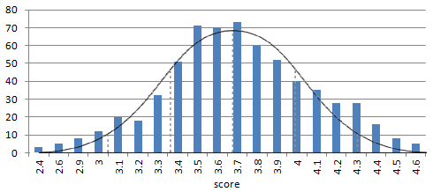
ASL Process Overview – RTLT Slotting
ASL Purpose
ASL Inputs / Outputs
ASL Process Overview
Review Time / Lead Time Slotting
Determine Seasonality
Demand Profiling
Case Pack Adjustment
Assumptions and Caveats
Questions
Appendix
RTLT Slotting
Pull all combinations of review time lead-time from past two years
Order from least to greatest
Sample 25 instances at regular percentiles
Historic Occurrences
Days
RT-LT Times
Sample RTLT’s
*additional RTLT info in Appendix-1

Slide 8
ASL Process Overview – RTLT Slotting
ASL Purpose
ASL Inputs / Outputs
ASL Process Overview
Review Time / Lead Time Slotting
Determine Seasonality
Demand Profiling
Case Pack Adjustment
Assumptions and Caveats
Questions
Appendix
RTLT Slotting
Pull all combinations of review time lead-time from past two years
Order from least to greatest
Sample 25 instances at regular percentiles
Example: Sku 674487 (Basting Brush). Store 3015 (STL, MO)
RT History 1-3 days: LT History 3-10 days
Historic Occurrences
4
7
9
9.2
9.4
9.5
10
10.5
12
13
Days
RT-LT Times
*additional RTLT info in Appendix-1

Slide 9
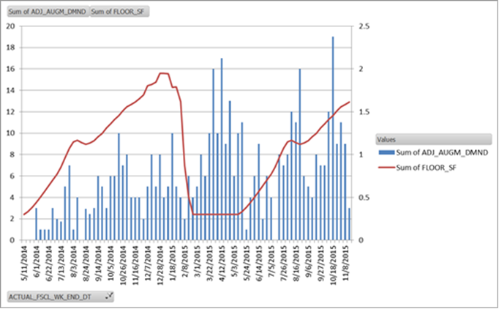
ASL Process Overview – Seasonality
ASL Purpose
ASL Inputs / Outputs
ASL Process Overview
Review Time / Lead Time Slotting
Determine Seasonality
Demand Profiling
Case Pack Adjustment
Assumptions and Caveats
Questions
Appendix
Determine Seasonality
Compare Str-Sku SF against subclass weatherzone (check for large mis-match)
Check for Predictability
Predictability:
Flag as non-seasonal when AVG predicts sales better than SF
*additional SF info in Appendix-2

Slide 10
ASL Process Overview – Seasonality
ASL Purpose
ASL Inputs / Outputs
ASL Process Overview
Review Time / Lead Time Slotting
Determine Seasonality
Demand Profiling
Case Pack Adjustment
Assumptions and Caveats
Questions
Appendix
Determine Seasonality
Compare Str-Sku SF against subclass weatherzone (check for large mis-match)
Check for Predictability
Example: Sku 674487 (Basting Brush). Store 3015 (STL, MO)
Non-seasonal ARS is a better predictor than seasonal forecast
*additional SF info in Appendix-2

Slide 11
ASL Process Overview – Demand Profiling
ASL Purpose
ASL Inputs / Outputs
ASL Process Overview
Review Time / Lead Time Slotting
Determine Seasonality
Demand Profiling
Case Pack Adjustment
Assumptions and Caveats
Questions
Appendix
Attach Demand Profile
De-seasonalize demand (appendix-3)
Control Outliers (appendix-4)
Generate Safety Stock Curves
Re-seasonalize (appendix-3)
Percentile Demand:
Observed Sales Over Period
4.1
4
3.9
For each RTLT value, the sum of sales is calculated across all possible RTLT periods from the last two years
All the resulting values are sorted and percentiles calculated
Slotted RTLT Values
1441
1307
1268
4-Week Sales = 1441
4-Week Sales = 1307
4-Week Sales = 1268

Slide 12
ASL Process Overview – Demand Profiling
ASL Purpose
ASL Inputs / Outputs
ASL Process Overview
Review Time / Lead Time Slotting
Determine Seasonality
Demand Profiling
Case Pack Adjustment
Assumptions and Caveats
Questions
Appendix
Attach Demand Profile
De-seasonalize demand (appendix-3)
Control Outliers (appendix-4)
Generate Safety Stock Curves
Re-seasonalize (appendix-3)
Example: Sku 674487 (Basting Brush). Store 3015 (STL, MO)
RTLT Sales Combinations
13-day Sales = 4
10-day Sales = 2
6-day Sales = 2

Slide 13
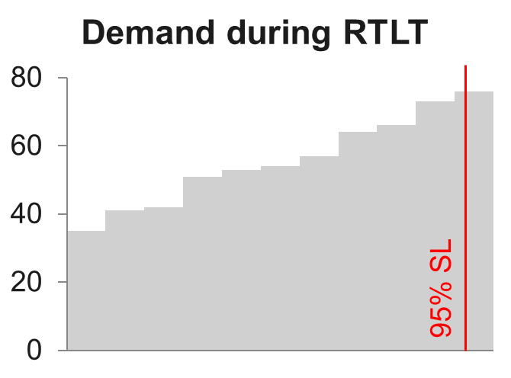
Demand Profiling (Cont)
ASL Purpose
ASL Inputs / Outputs
ASL Process Overview
Review Time / Lead Time Slotting
Determine Seasonality
Demand Profiling
Case Pack Adjustment
Assumptions and Caveats
Questions
Appendix
Attach Demand Profile
De-seasonalize demand (appendix-3)
Control Outliers (appendix-4)
Generate Safety Stock Curves
Re-seasonalize (appendix-3)
Mean of resulting percentile demand corresponds to cycle stock
SSU should cover remaining RTLT demand
Mean
50% SL
Safety Stock Curve

Slide 14
Demand Profiling (Cont)
ASL Purpose
ASL Inputs / Outputs
ASL Process Overview
Review Time / Lead Time Slotting
Determine Seasonality
Demand Profiling
Case Pack Adjustment
Assumptions and Caveats
Questions
Appendix
Attach Demand Profile
De-seasonalize demand (appendix-3)
Control Outliers (appendix-4)
Generate Safety Stock Curves
Re-seasonalize (appendix-3)
Example: Sku 674487 (Basting Brush). Store 3015 (STL, MO)
Current Set Service Level (91%)
Current SSU (.7, rounds to 1)

Slide 15
ASL Process Overview – Case Pack Adj.
ASL Purpose
ASL Inputs / Outputs
ASL Process Overview
Review Time / Lead Time Slotting
Determine Seasonality
Demand Profiling
Case Pack Adjustment
Assumptions and Caveats
Questions
Appendix
Adjust for Case Pack
OH + OO
OH+OO
OUTL
SSU Case Pack Adjustment
OUTL
Lowers SSU on items where case pack is very large relative to ARS and SSU.
Small amount of time where OH+OO drops below unadjusted OUTL is offset by the long periods where OH is well above OUTL – overall Depth closer to set SL
SSU can be reduced by up to 50%
Reduction phased out for SL above 98. No reduction at 99.8

Slide 16
ASL Assumptions and Caveats
ASL estimates the amount of safety stock required to attain a given service level
Service level: the percentage of replenishment cycles that an item will not go out of stock (e.g., one review time + lead time).
Assumes cycle stock covers seasonalized ARS (i.e., forecast = mean demand)
Assumes all demand is incremental and all demand is filled until there is an out of stock (i.e., there is no JLQ activity where a customer will buy 20 units if there are 20 OH, but 0 units if there are 19 OH)
Assumes historical demand and LT variation is representative of future demand and LT variation
Data is pulled from DCM weekly demand history (weekly_prod_dmnd)
Only considers DCM status <30 or 55 (100,200 or copy sales)
Pulls copy sales that occurred before an item’s first regular sale
Uses revised demand instead of regular demand where revisions have been made
Uses up to 2 years of data if present
ASL Purpose
ASL Inputs / Outputs
ASL Process Overview
Review Time / Lead Time Slotting
Determine Seasonality
Demand Profiling
Case Pack Adjustment
Assumptions and Caveats
Questions
Appendix

Slide 17
ASL Assumptions and Caveats Cont.
Managing ASL
Set and observed service are much closer
Case pack, presentation minimums, maxes will still drive some items
Seasonal items automatically load-in
SSU is based on the seasonal factors over the next RTLT weeks
SSU will gradually go up starting RTLT weeks before first week of season
WOS Min parms still necessary to account for seasonal timing risks
ASL for new items starts calculating three RTLTs after first sale
Still need to watch new SKUs closely
Should use New SKU MOHQ until demand stabilizes
New SKUs with sister SKU copy sales will receive SSU on activation
Driven by sales history – can’t manage the unprecedented
ASL Purpose
ASL Inputs / Outputs
ASL Process Overview
Review Time / Lead Time Slotting
Determine Seasonality
Demand Profiling
Case Pack Adjustment
Assumptions and Caveats
Questions
Appendix
Managing New Service Levels
“Service Level Curve” report
Estimates inventory impact of service level changes without the need for a full simulation

Slide 18
Questions
ASL Purpose
ASL Inputs / Outputs
ASL Process Overview
Review Time / Lead Time Slotting
Determine Seasonality
Demand Profiling
Case Pack Adjustment
Assumptions and Caveats
Questions
Appendix

Slide 19
Appendix
ASL Purpose
ASL Inputs / Outputs
ASL Process Overview
Review Time / Lead Time Slotting
Determine Seasonality
Demand Profiling
Case Pack Adjustment
Assumptions and Caveats
Questions
Appendix
The following slides are supplemental information to the above presentation

Slide 20
Appendix-1: Calculating lead times
Based on past 200 days of LTs
Logic similar to CAR and SYNC LT calculations
One entry per PO
Outlier control
RDC and RDCx LTs pooled at Vendor to RDC and RDC to store then recombined to form vendor to store LT
25 values sampled at quantiles
Pulls the 25 values from 2nd to 98th percentile (2nd,6th,10th…94th,98th)
Reduces total number of weeks without distorting distribution shape
Adds review time based on CAR or EFS review time

Slide 21
Appendix-2: Seasonal factors
Forecasting team builds seasonal profiles for all str-SKUs
Individual str-SKUs adopt a profile that matches others in the same subclass weather zone (though clustering sometimes happens at higher or lower level)
Generally updated once a year
Seasonal profile assigns a “seasonal factor” to each fiscal week
The 52 seasonal factors should sum to 52
Essentially each seasonal factor is a multiplier for the 52 week ARS
If you sell 208 a year, you sell 4 per week on average. If you expect to sell 8 a week in FW 12, then your SF would be 2
ASL preps these SFs in several ways before consuming
Smooths SF over 3 weeks – reduces the noise in low sales volume STR-SKUs
Floors all values at .3 – avoids complete loss of SSU out of season
Tests for 5 consecutive weeks of values above 1.2 before considering an item seasonal
Deseasonalized demand = demand quantity/smoothed SF

Slide 22
Appendix-3: De/Re - seasonalize
De-seasonalize:
A STR-SKU is seasonal if all the following are true:
5 consecutive weeks with SF above 1.2
SF*mean is a better predictor of sales history than just mean
Using SF will not create inventory overage
For seasonal str/SKUs, de-seasonalized demand is used
Revised demand/SF
All demand values where SF <.75 are set to null
Otherwise items will be treated as non-seasonal
just use revised demand
Re-Seasonalize:
Seasonal STR-SKUs will have a de-seasonalized SSU that corresponds to a seasonal factor of 1
SSU is multiplied by the average of SFs over the next RTLT weeks to yield a seasonal SSU

Slide 23
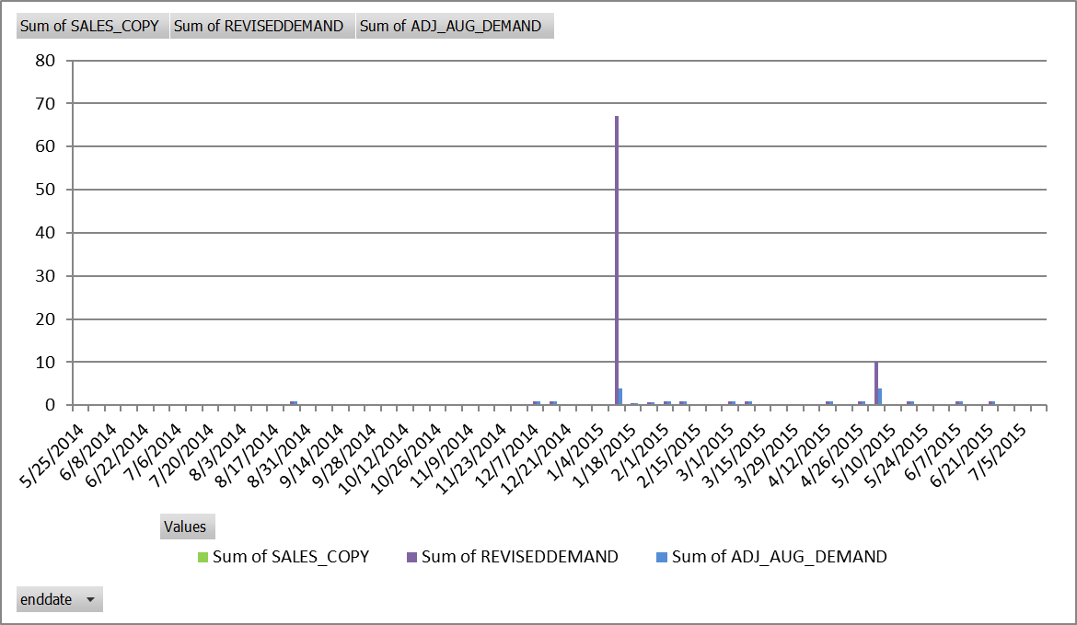
Appendix-4: Control Outliers
Tests individual store-sku demand history for large relative differences in quantity
Looks at the top demand values
Up to 6 values
0 at 1 quarter, 3 at 1 year, 6 at two years
If any of the top values are more than 4 times larger than the next highest value, (caps top values at 4x next largest value)
Tests are performed on both actual and de-seasonalized demand history

Slide 24
Appendix-5: Test seasonal profile predictive value
Seasonal profiles can be inaccurate
STR-SKU doesn’t follow subclass pattern
New item behavior interpreted as seasonal behavior
First test of seasonal profile: does using the seasonal profile predict demand better than ARS?
Finds the differences between actual demand and both the 52 week ARS and 52 week ARS * SF
Items whose 52 week ARS is a better predictor than seasonal mean will be treated as non-seasonal
Problem: seasonal items with inaccurate seasonal profiles are treated as non-seasonal using this method

Slide 25
Appendix-6: Test seasonal factor inventory overage
Reject curves that have large mismatches with actual sales
Test overall variance (computationally expensive)
Test largest RTLT misses
Computationally cheap
Directly proportional to SSU impact
Max raw demand (4 week rolling)
Week | Demand | SF
15 | 6 | 3
16 | 6 | 3
17 | 6 | 3
18 | 6 | 3
Max deseasonalized demand (4 week rolling)
Week | Demand | SF | Deseasonlized demand
45 | 5 | 0.8 | 6.25
46 | 5 | 0.8 | 6.25
47 | 5 | 0.8 | 6.25
48 | 5 | 0.8 | 6.25
Max SF: 4
100
25
24
= 4.17
24
x 4
100

